Slide 1

SCALABLE DATABASE – CS 673 FINAL PROJECT PHASE 2.
Group 5.

Slide 2

Members:
Inamdar , Ali Suhel
Chinnaobaiahgari, Likhitha
Maniyar, Krishna Kirit
Jha, Shivam

Slide 3
Contents:
Downloading 30,00 rows of random data from the given data website.
Combining all datasets.
Performing EDA.
Applying Machine Learning models to the dataset.
Evaluating the model.
Importing the target dataset.
Evaluating & Predicting the delay for the target dataset.
Printing out the outputs.
Conclusion.

Slide 4
Data Source:
Data Expo 2009: Airline on time data.
The data represents flight arrival and departure details for all commercial flights within the USA for all years.
Download link: Data Expo 2009: Airline on time data

Slide 5



Steps for working in Hadoop and downloading 30,00 random rows from the dataset.
Step 1: Extracting the data from the site and download the csv file from the website.
Step 2: Creating a Hive table and load all the file data into it. Prefix the table name with your name.
Step 3: Use Random Sampling in Hive to get 30,000 random rows from the entire dataset and save into another table.
Step 4: Use Hadoop to download to the saved 30,000 rows onto your local computer.

Slide 6
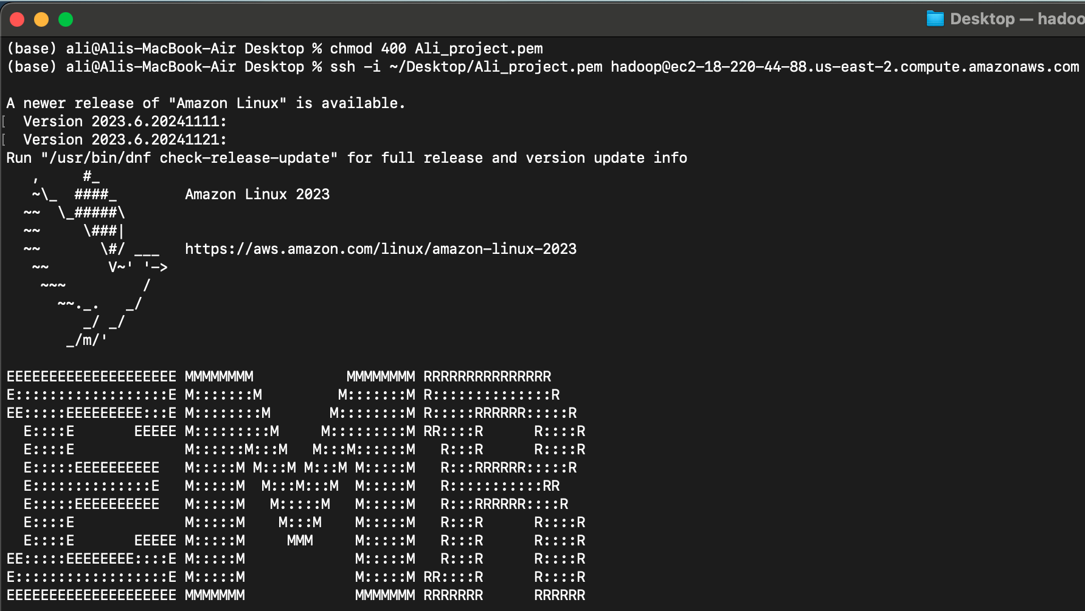
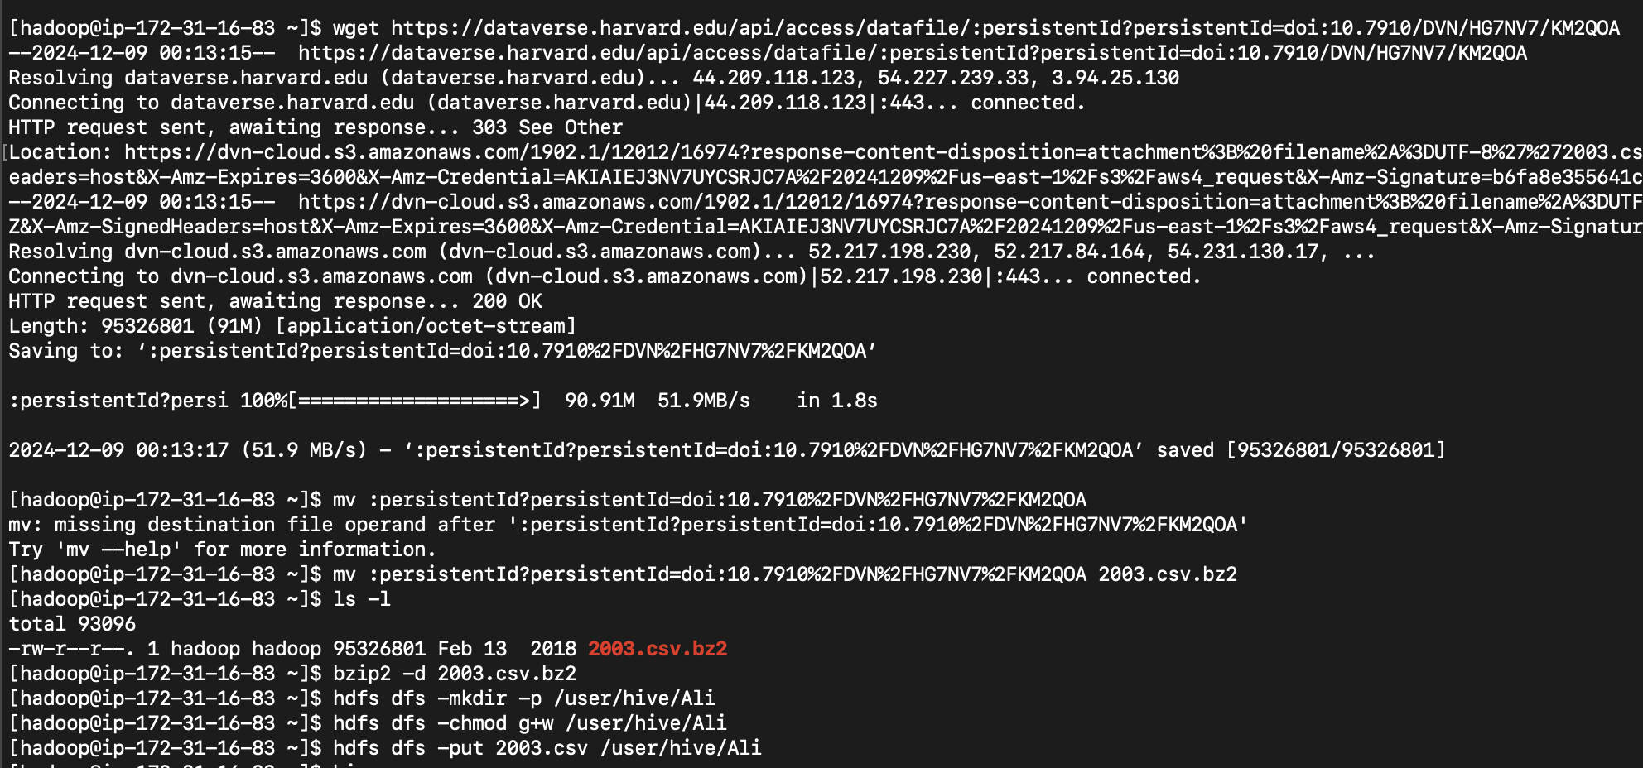
Loading up the EMR Cluster and importing the 2003-year csv.

Slide 7
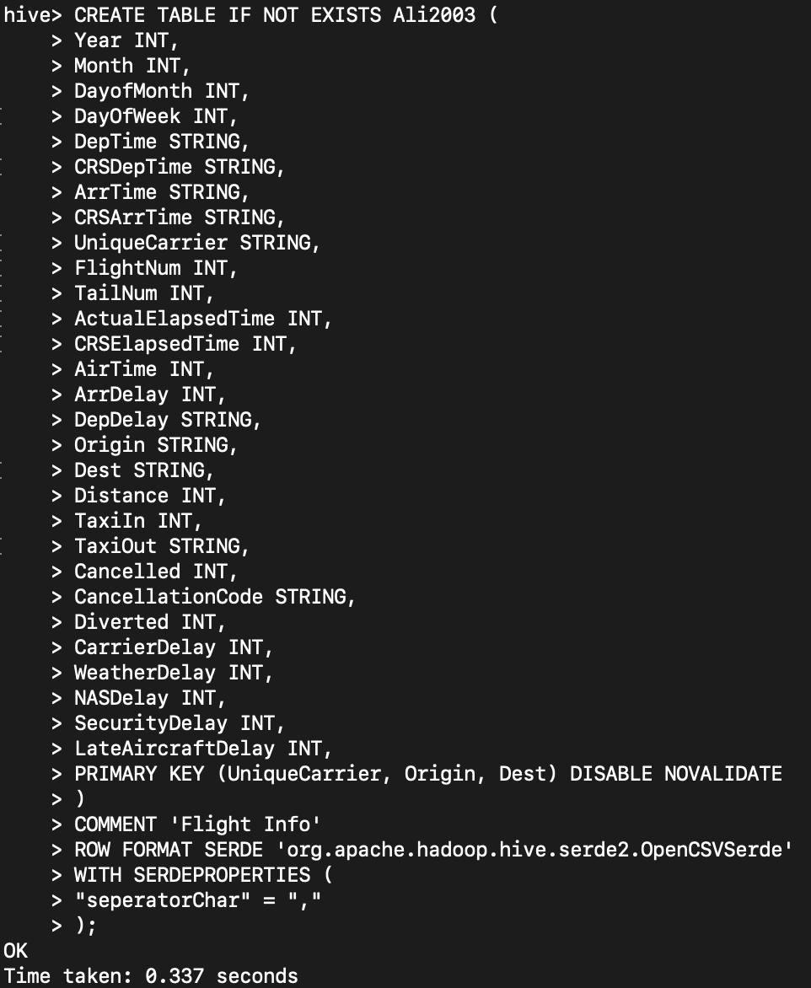
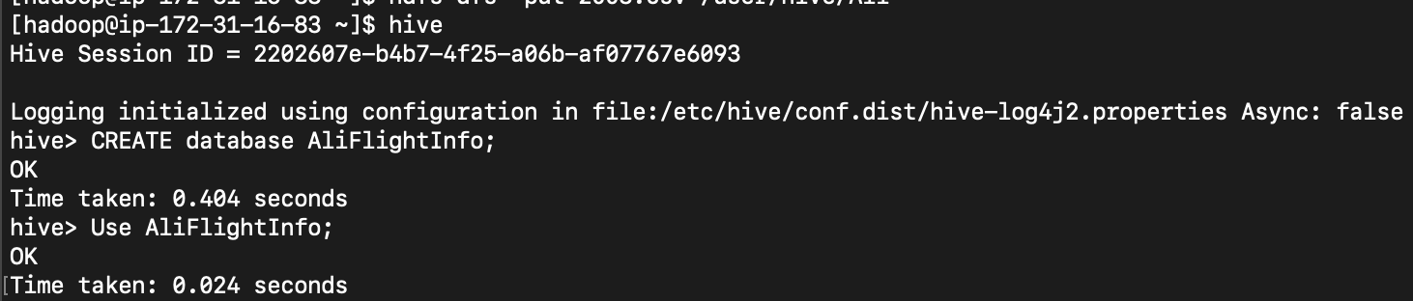
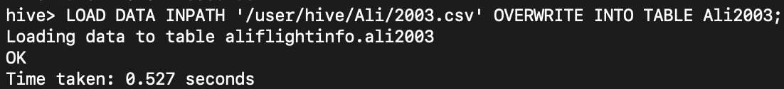
Creating a new table in hive to extract the full dataset from the data website and loading it into the table.

Slide 8
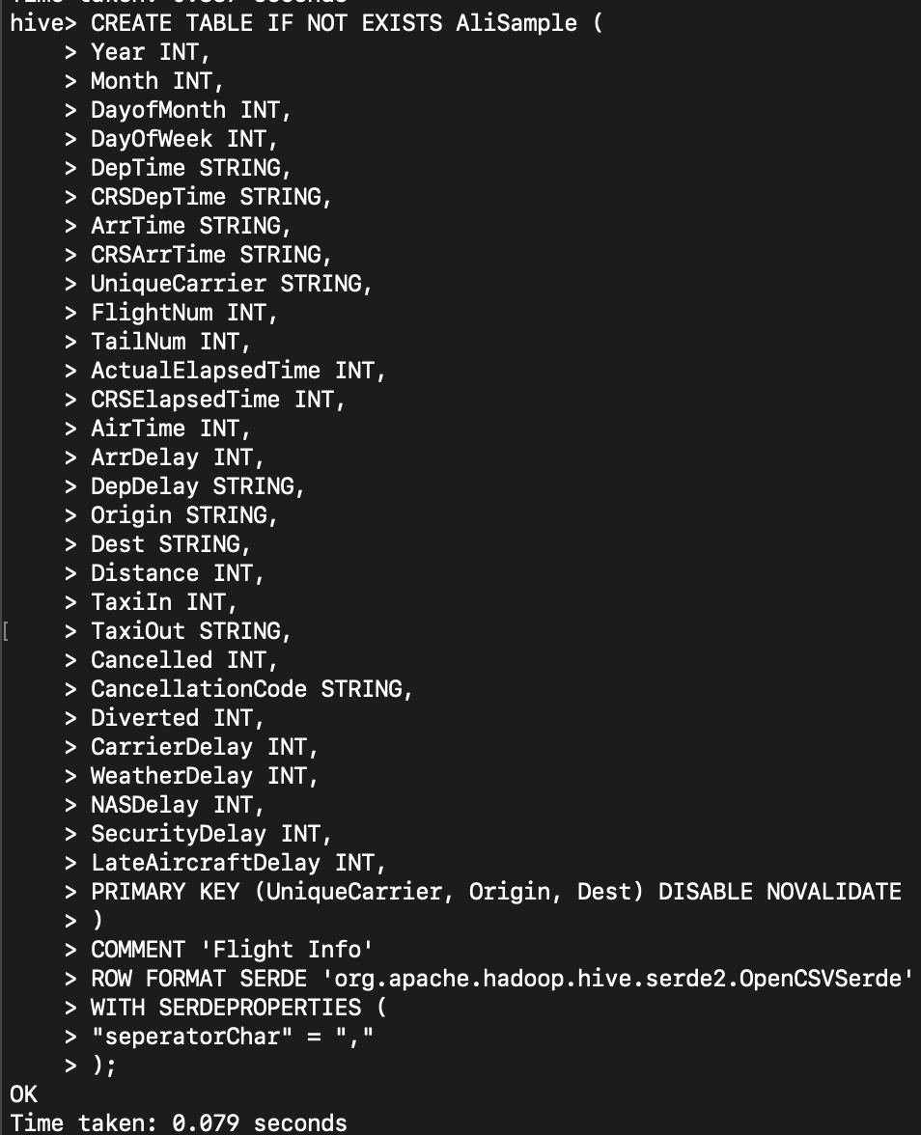
Creating a new table to hold the randomly selected 30,000 rows.

Slide 9
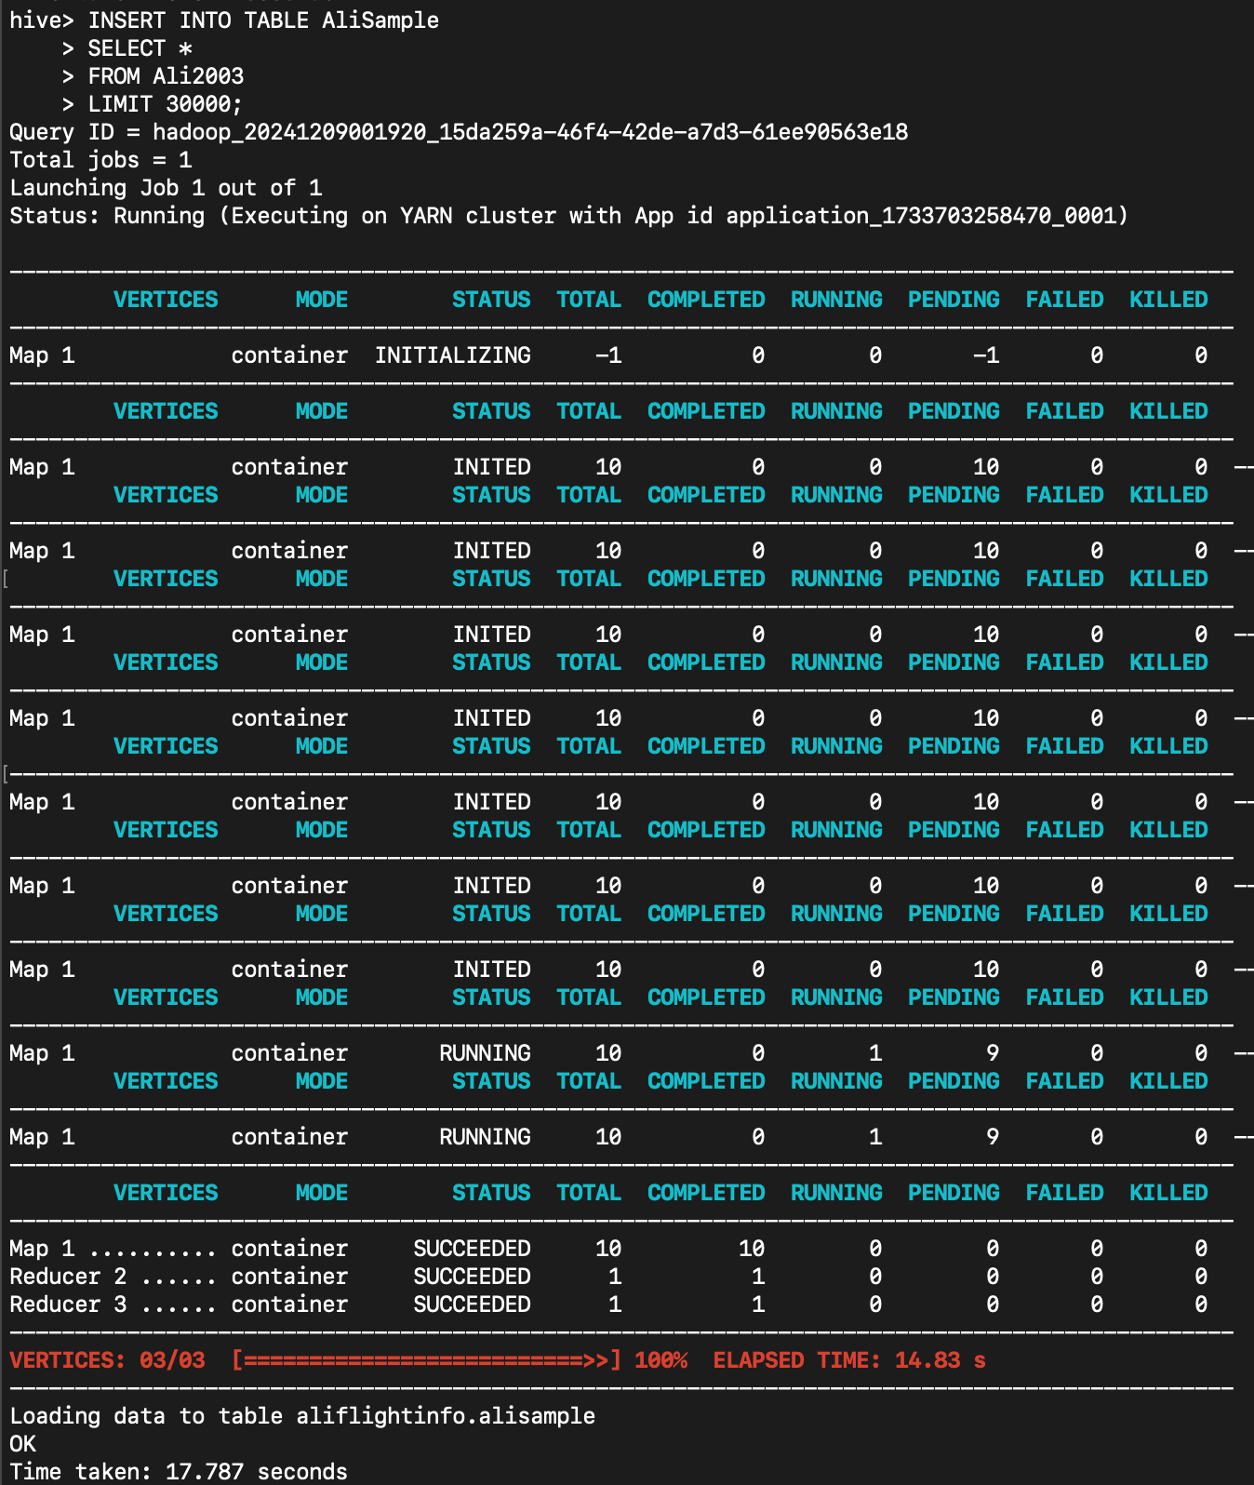
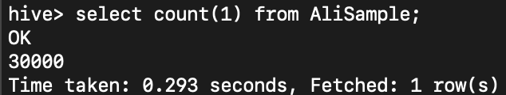
Using Random Sampling in Hive to select 30,000 random rows from the entire dataset and put it into the newly created table: AliSample.

Slide 10
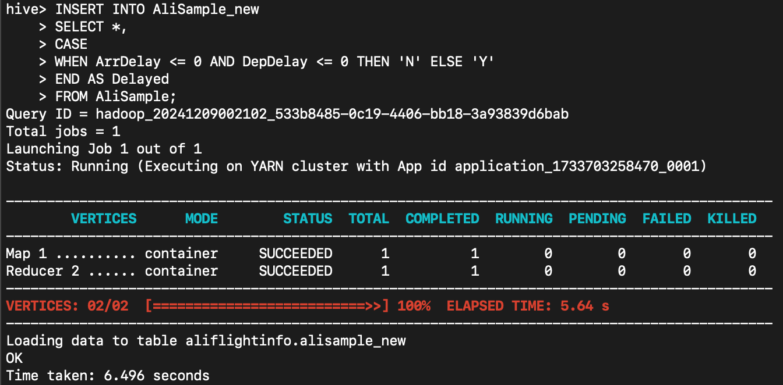
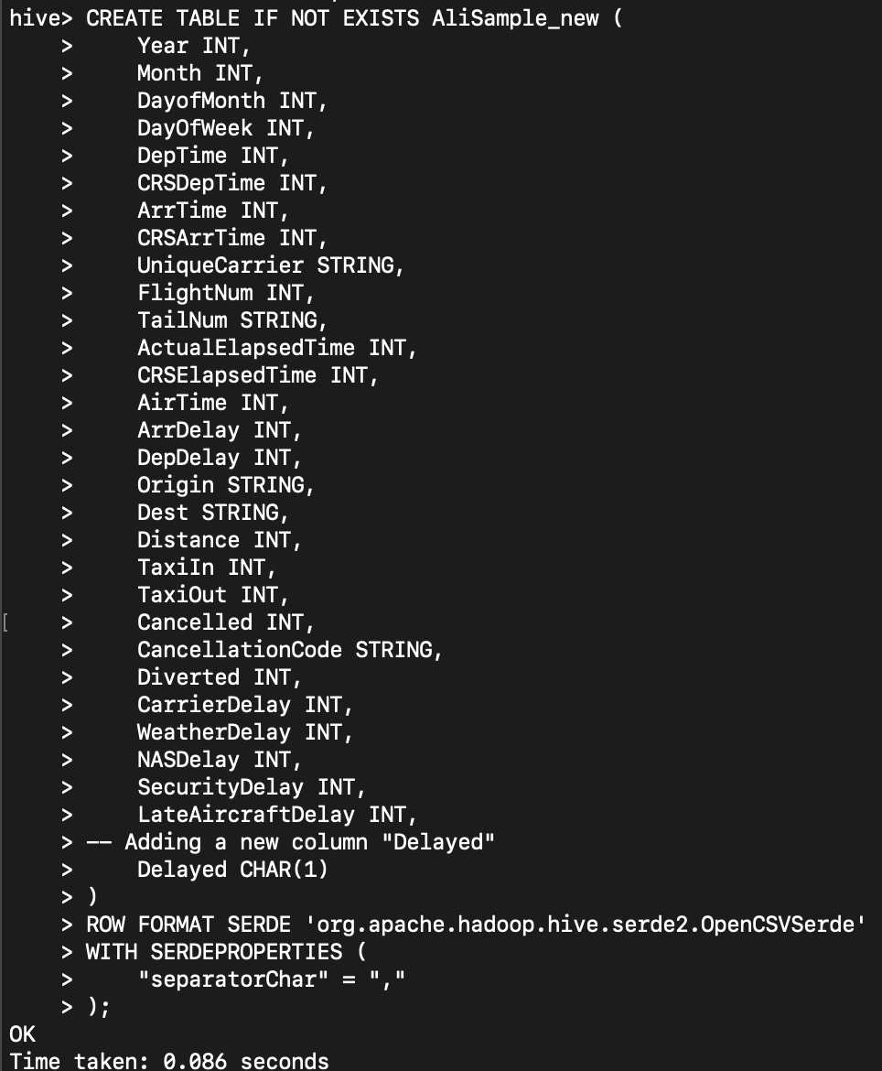
Applying The delay logic to new rows and putting them into a new table and adding a column displaying the delay in Boolean values(Y/N).

Slide 11
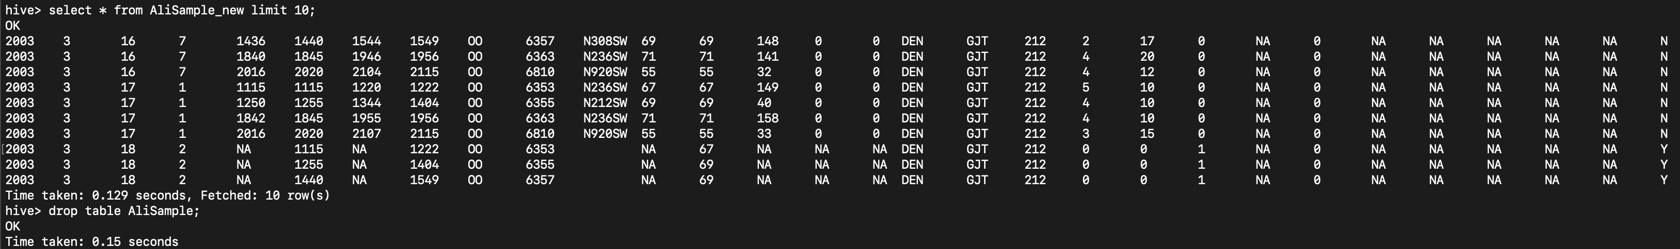
Displaying 10 rows of the new table with the delay column.

Slide 12
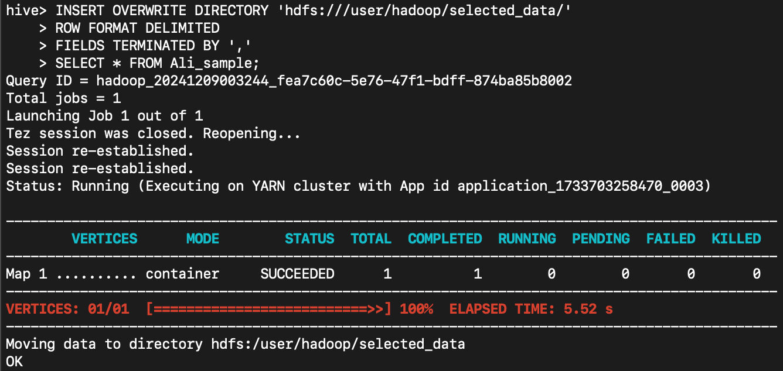
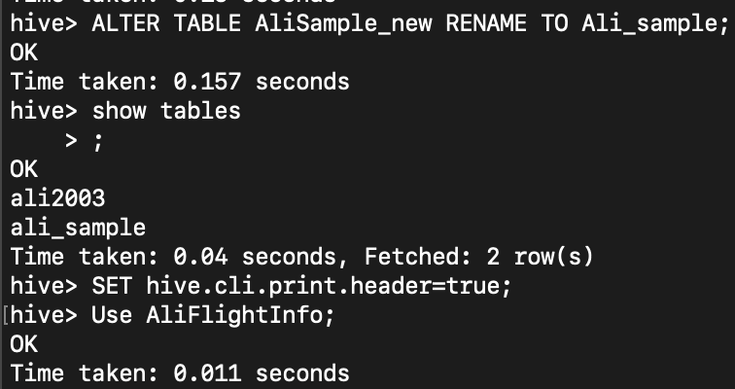
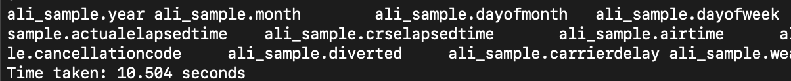
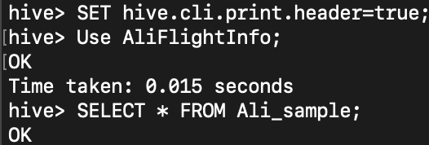
Adding a Header to the table

Slide 13
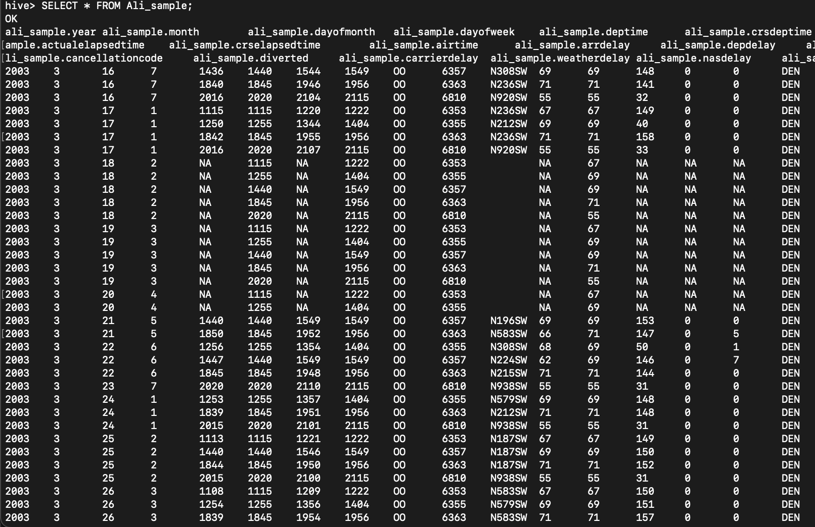
Displaying the new table containing the randomly sampled 30,000 rows and the header.

Slide 14
1. Downloading the new table:
- First you will need to convert the table into a csv file in Hadoop.
- Then , To Download the newly created table onto your local computer , you will need to use the ”scp” command along with the EMR cluster host id with the paths to your csv file directory, the path to your local computer directory respectively.
COMMAND:
“scp -i /Users/ali/Desktop/Ali_project.pem hadoop@ec2-3-145-141-244.us-east2.compute.amazonaws.com/home/hadoop/2008_data.csv .”
Here, the “.” at the end of the command shows us that we want to download our csv file on our current path in accordance with the terminal.

Slide 15
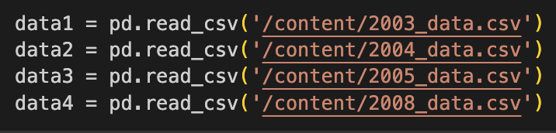
2. Combining all the datasets:
- Before combining all 4 datasets , we have to check and rename all columns so that they are similar.
Now, that all the tables have the same column names we can merge all the datasets into one single data frame.

Slide 16
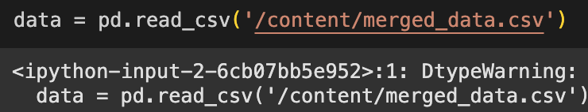
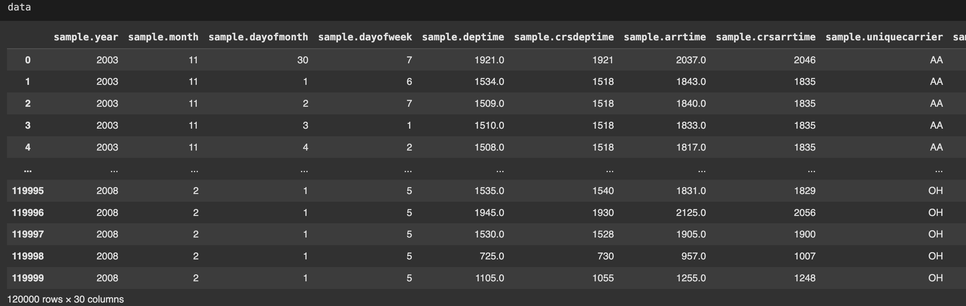
Now, we have a full dataset containing a 120,000 rows, which is a combination of all for datasets.

Slide 17

Data Pre-processing , Cleaning & Wrangling

Slide 18
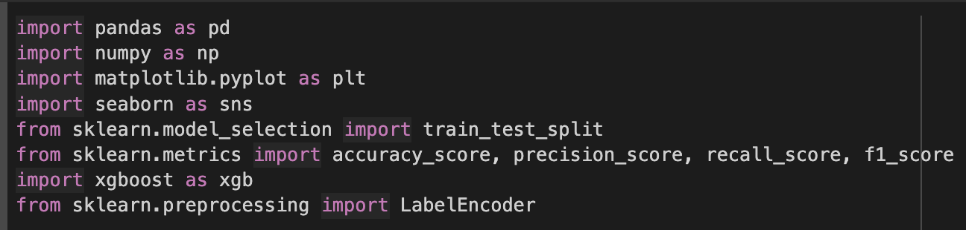
Importing all the libraries required for this project:

Slide 19
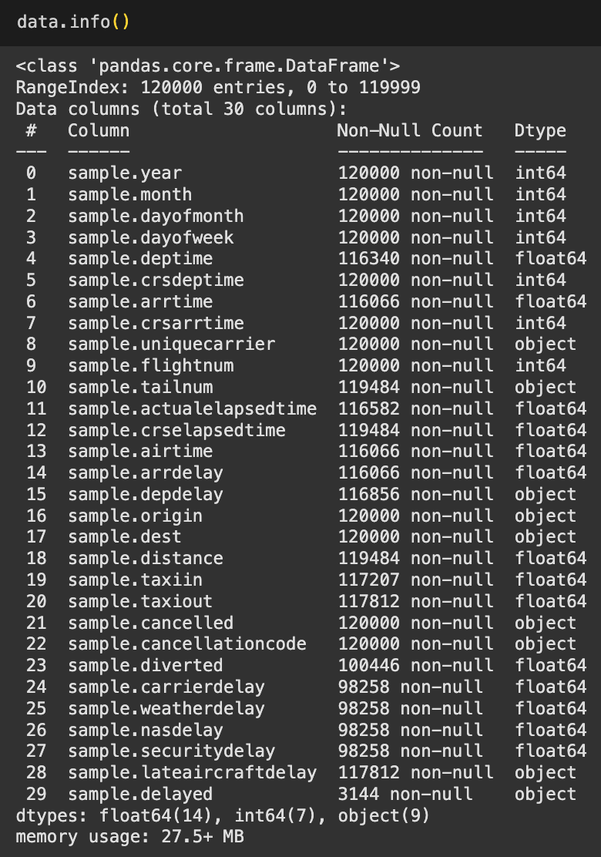
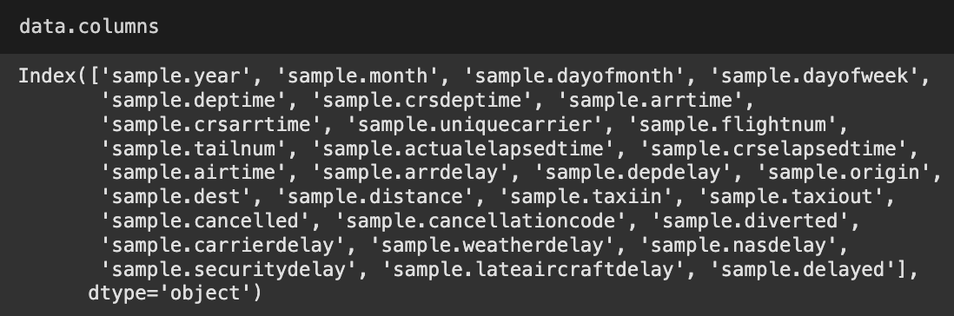
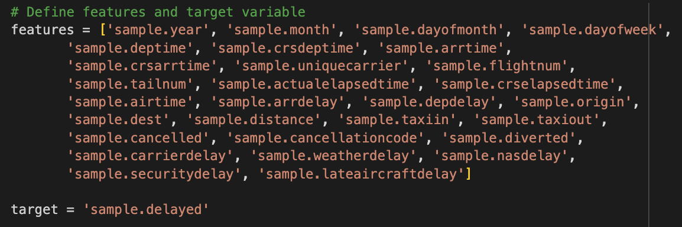
Information about the dataset.

Slide 20
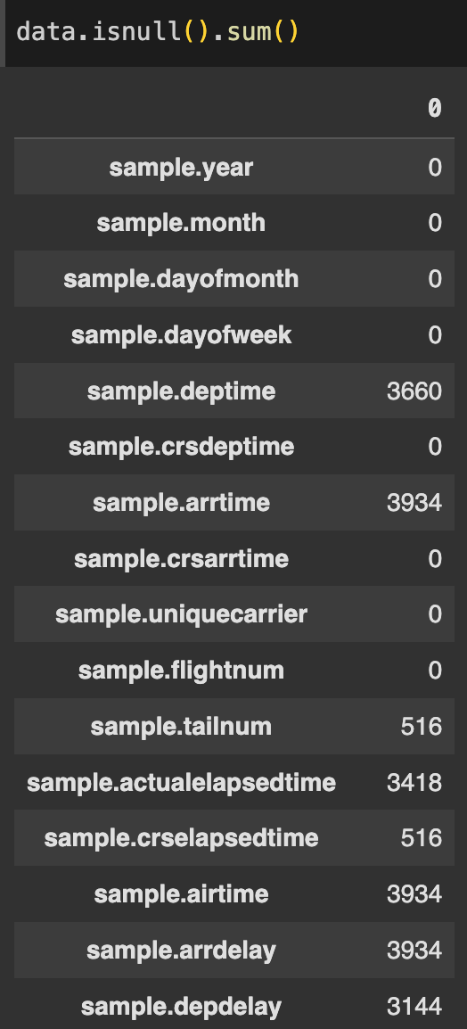
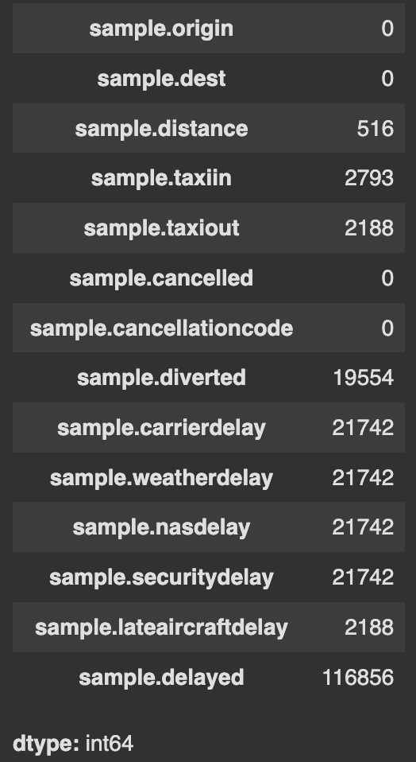
Checking for NULL values in the dataset:

Slide 21

3. Exploratory Data Analysis:

Slide 22
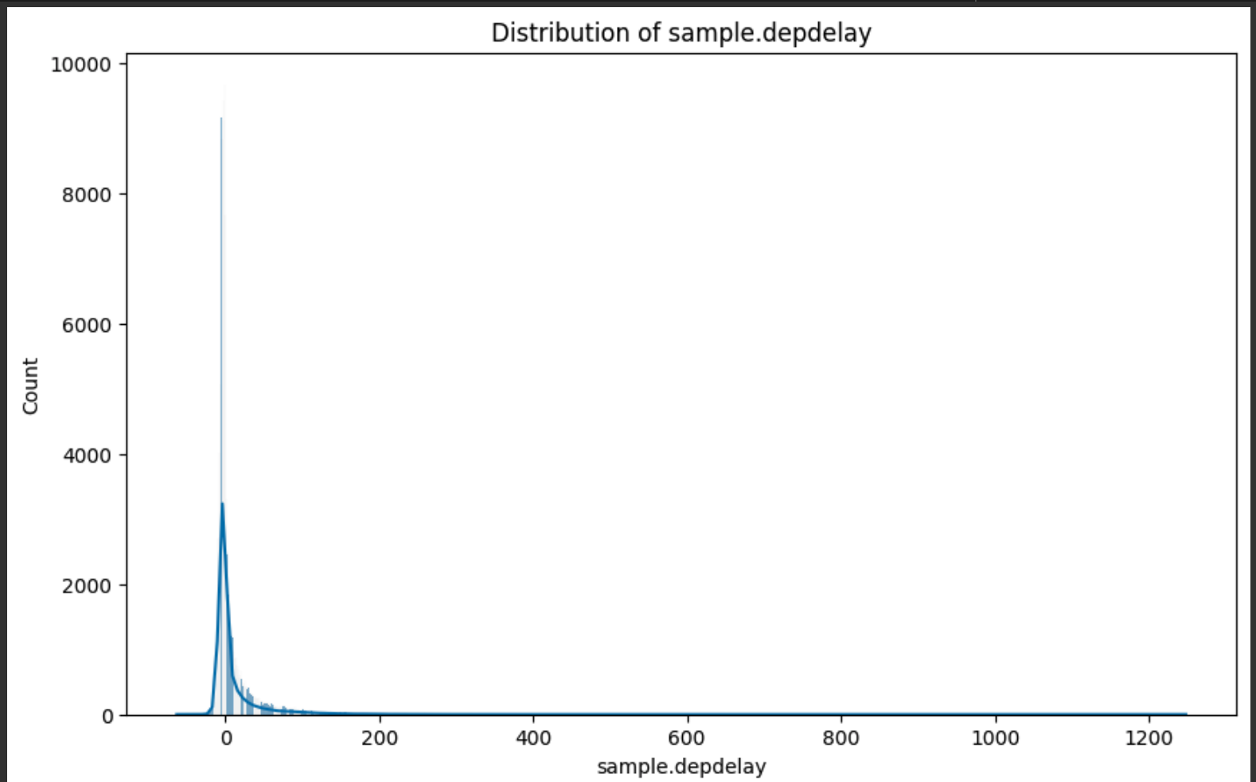
Graph for Delay in Departure.

Slide 23
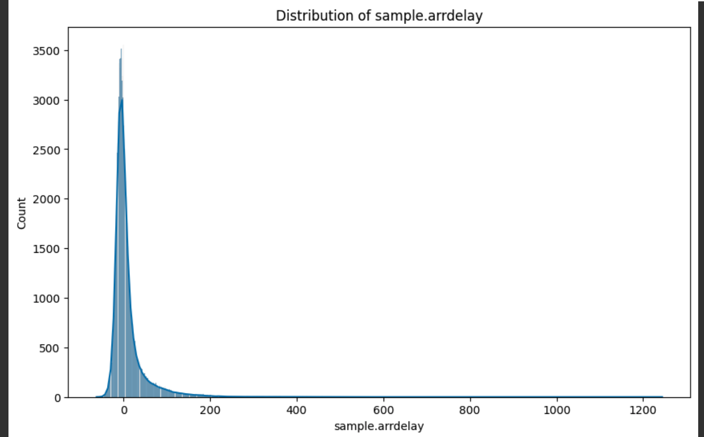
Graph for Delay in Arrival.

Slide 24
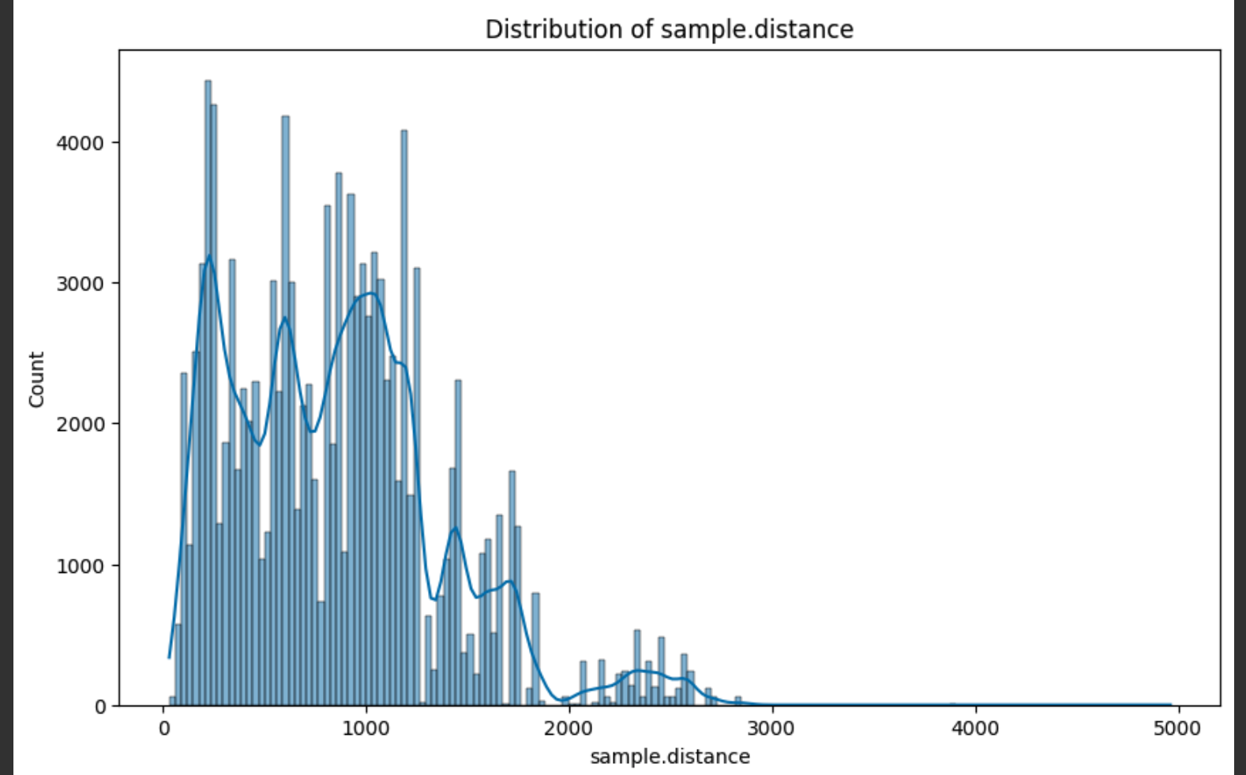
Distribution of Distance of Flights.

Slide 25
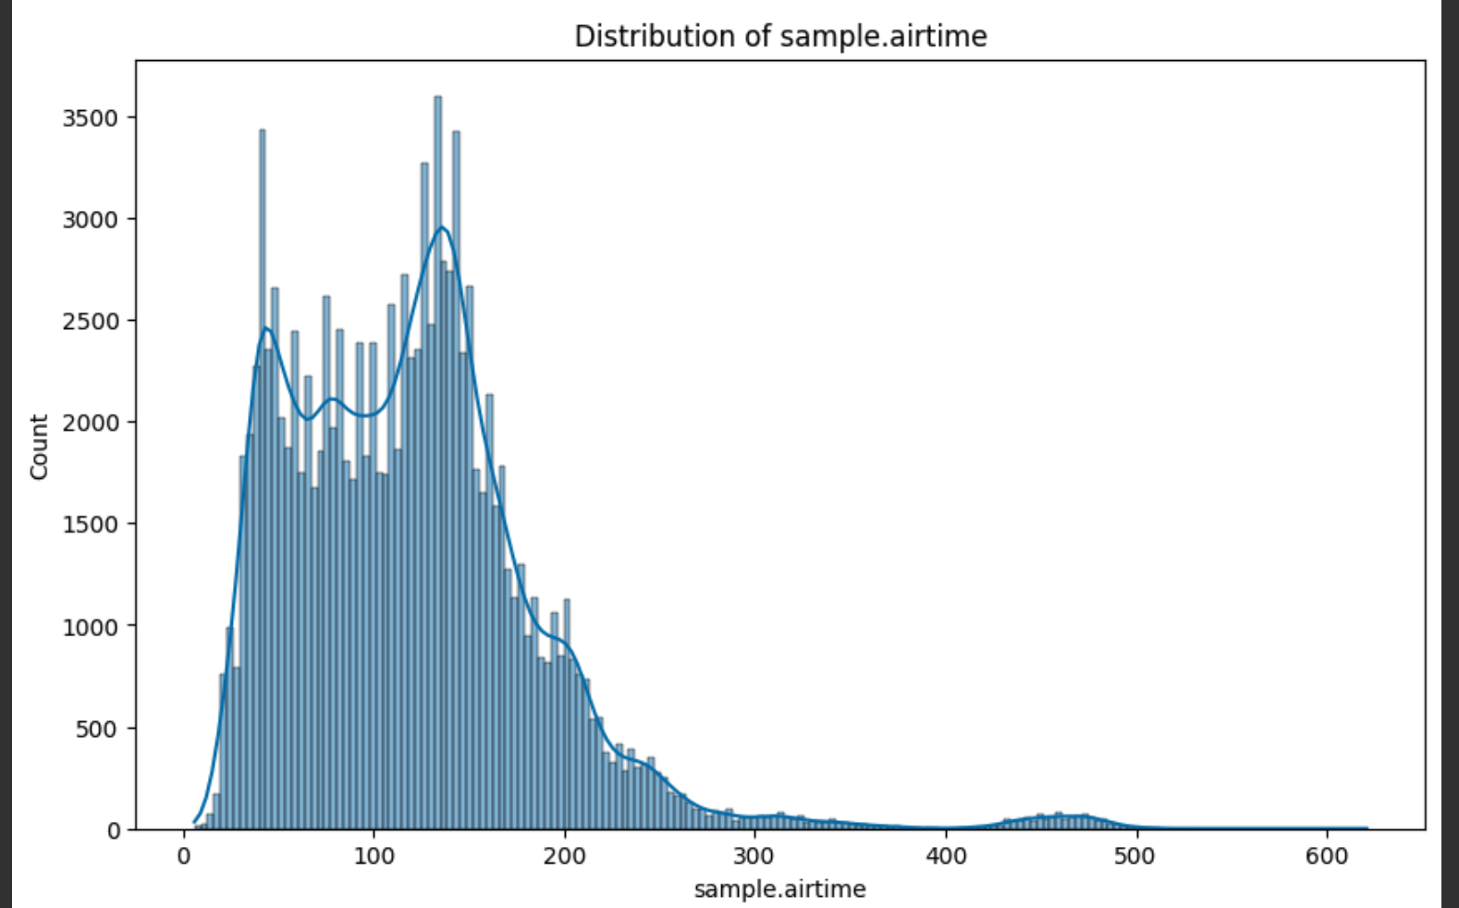
Distribution of Airtime.

Slide 26
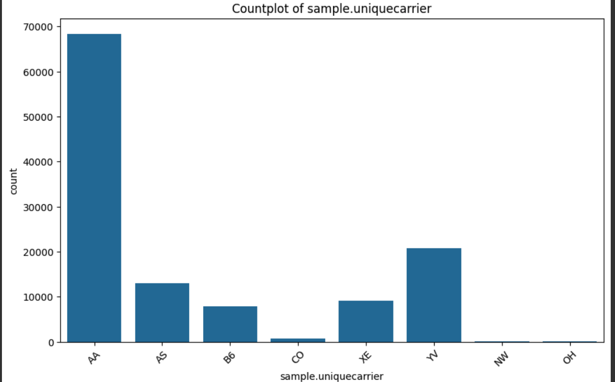
Unique Air Carriers.

Slide 27
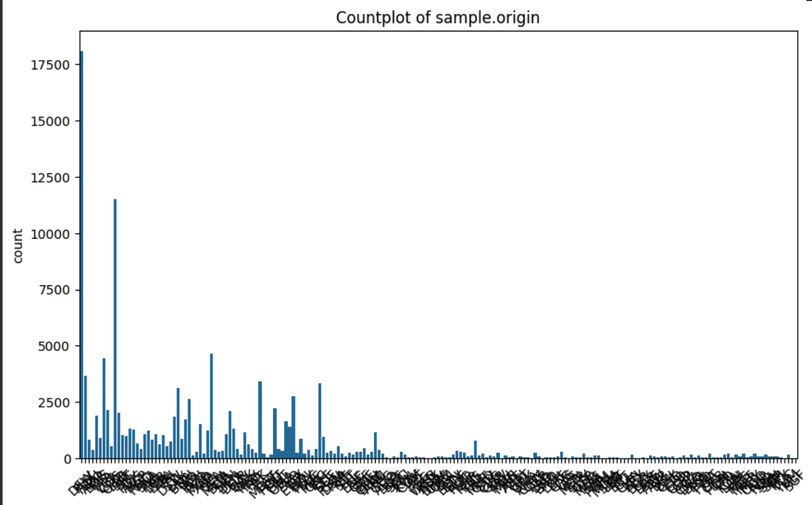
Origin Airports.

Slide 28
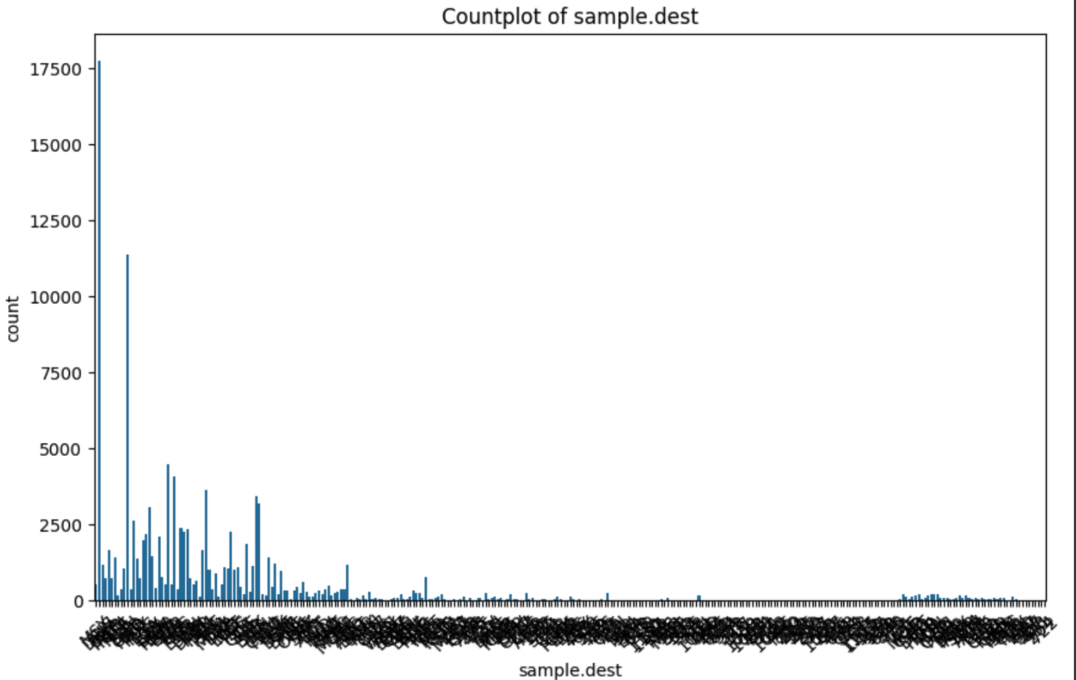
Destination Airports.

Slide 29
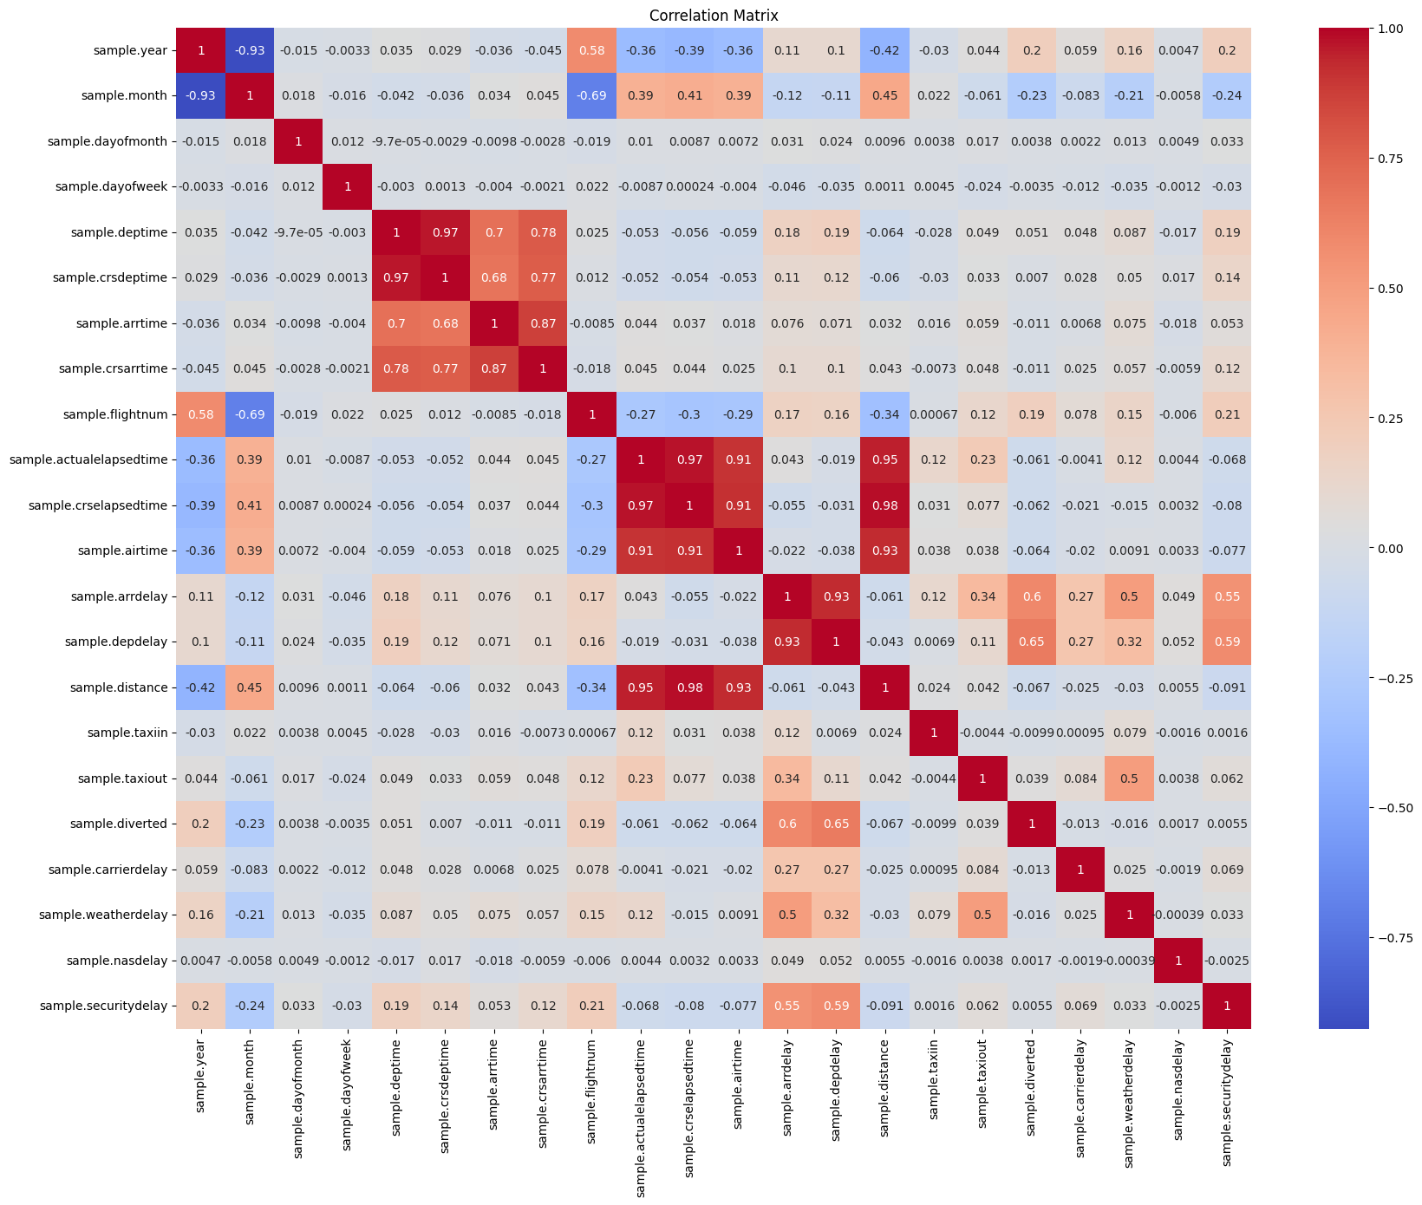
Correlation Heatmap.

Slide 30
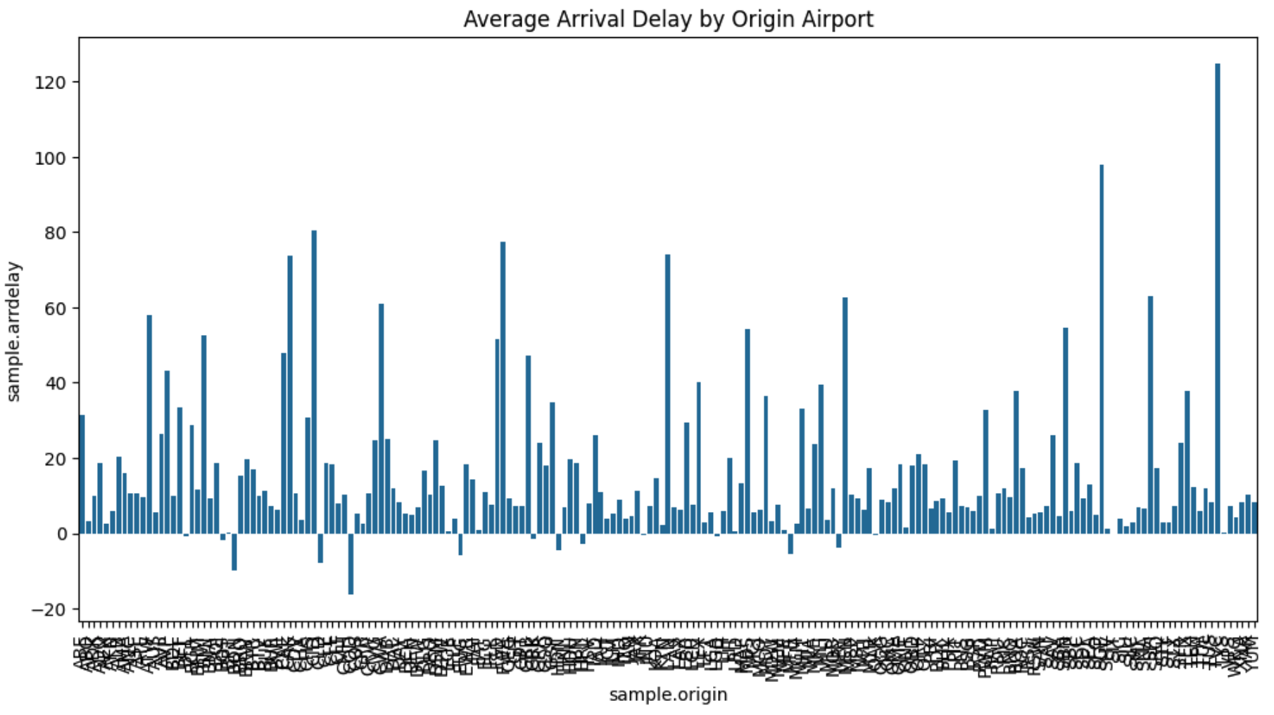
Avg. Arrival Delay by Origin Airport.

Slide 31
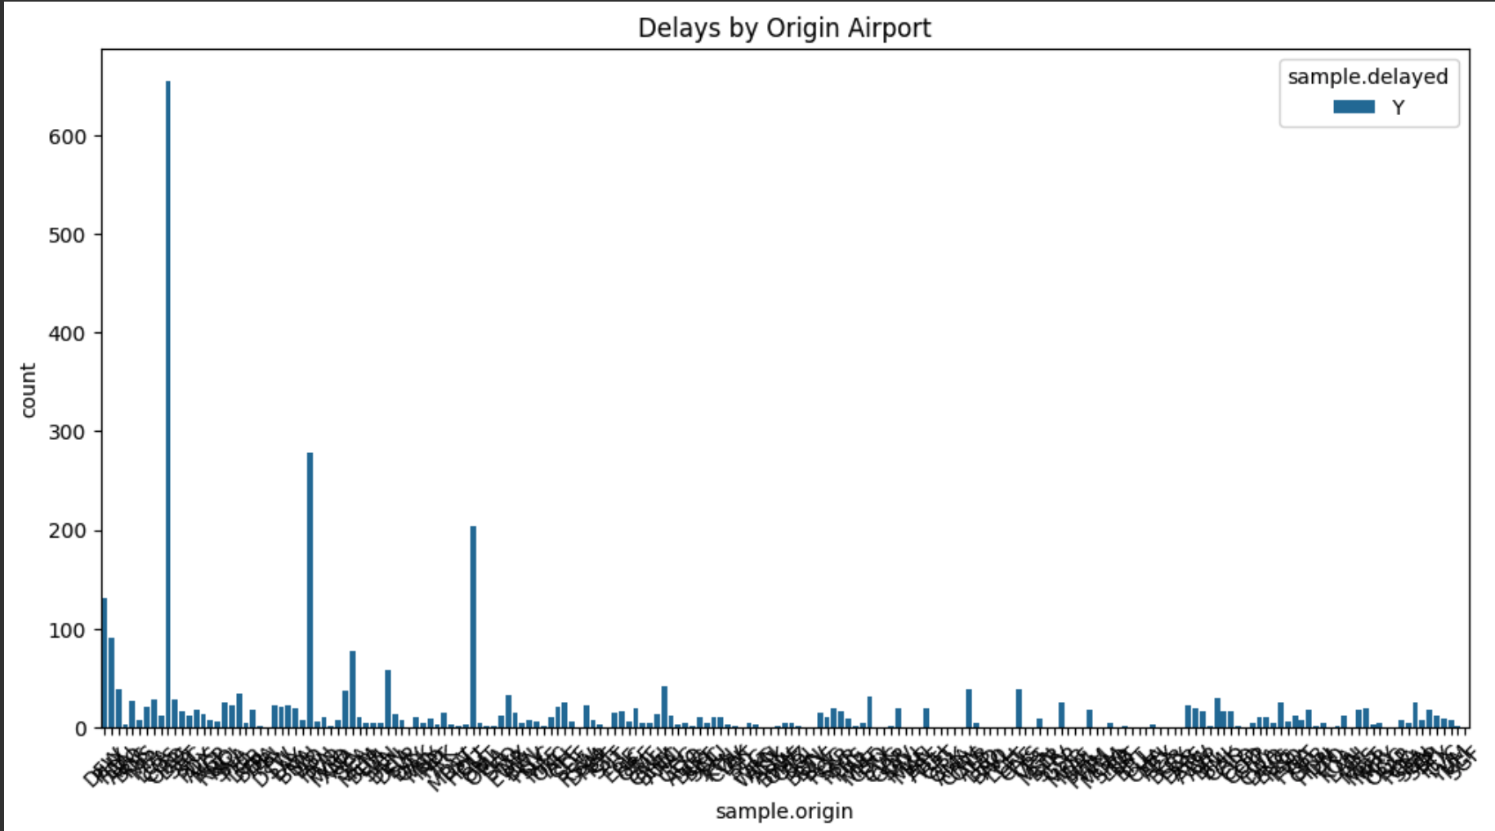
Delay at Origin Airport.

Slide 32
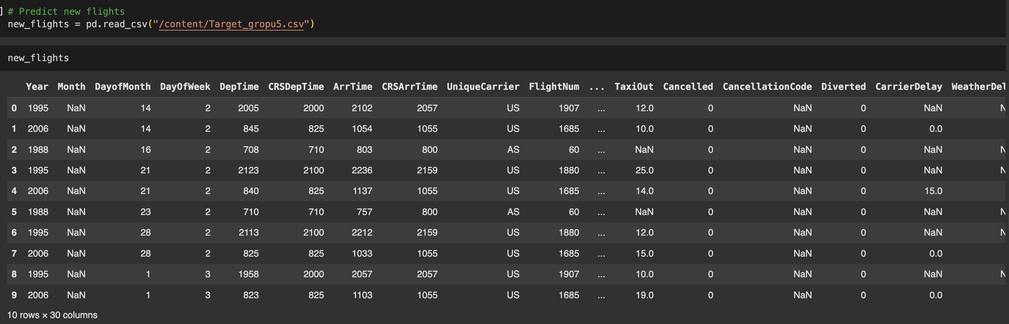
Target Dataset:

Slide 33
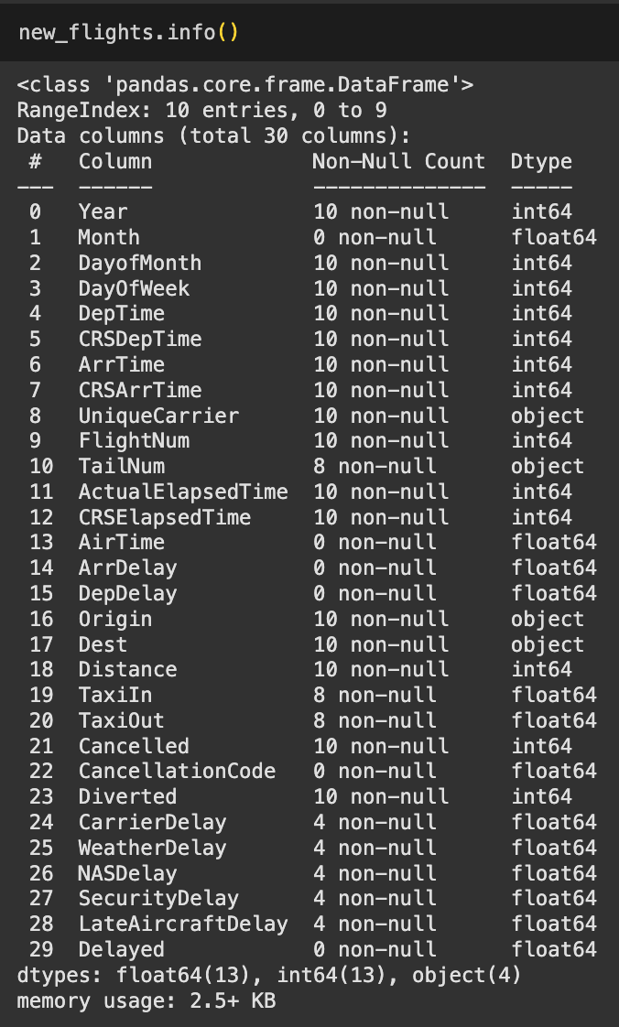
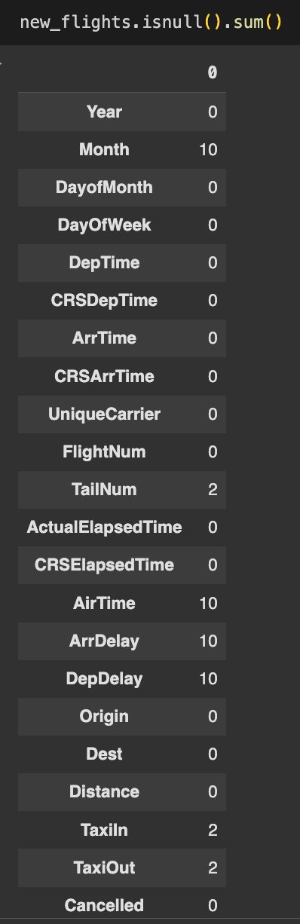
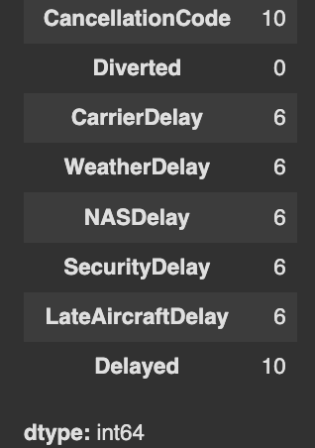
Information about the target dataset
Printing out the NULL values in the target dataset

Slide 34

4. Applying Machine Learning Models:

Slide 35
List of Machine Learning Models used by the group:
Ali - XGBosst Algorithm(HyperParameter Tuned)
Likhtiha – CATBoost Algorithm.
Krishna – Random Forest
Shivam - Logistic Regression

Slide 36
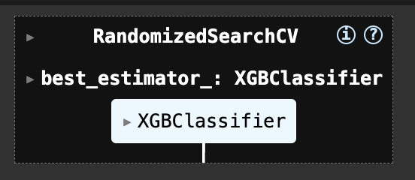
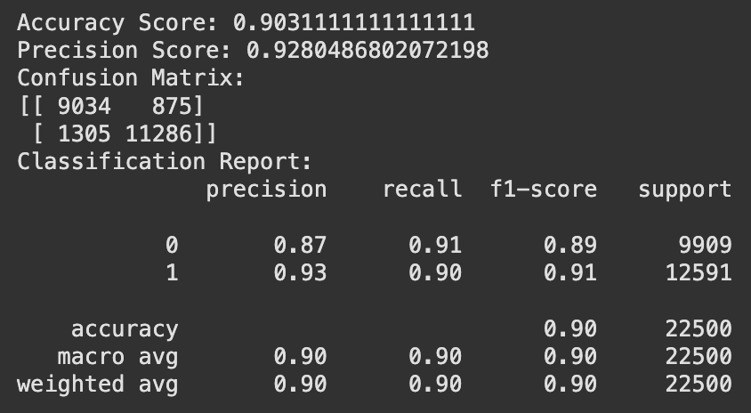
Ali – XGBoost Algorithm(Tuned):
Results:

Slide 37
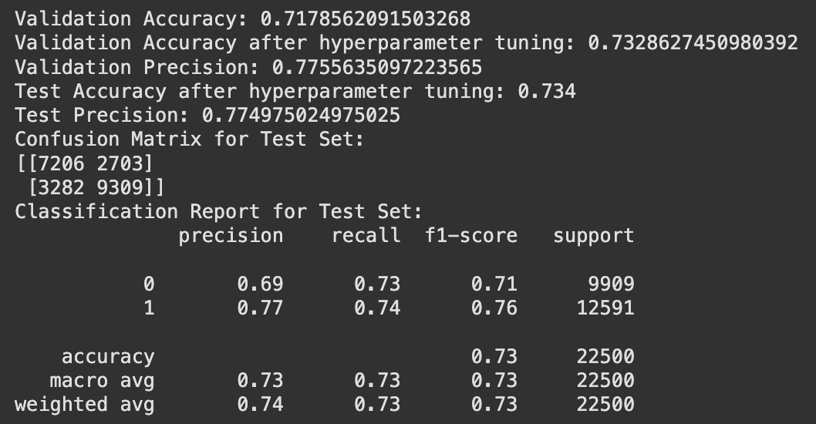
Likhitha – CATBoost Algorithm
Results:

Slide 38
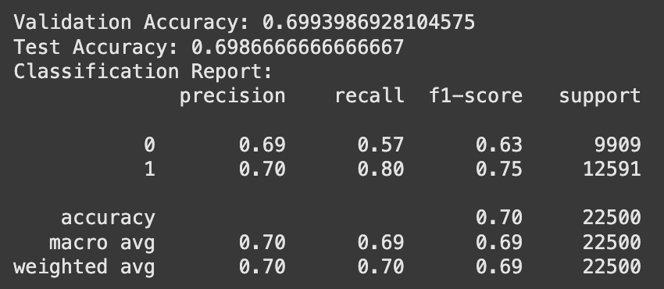
Krishna – Random Forest:
Results:

Slide 39
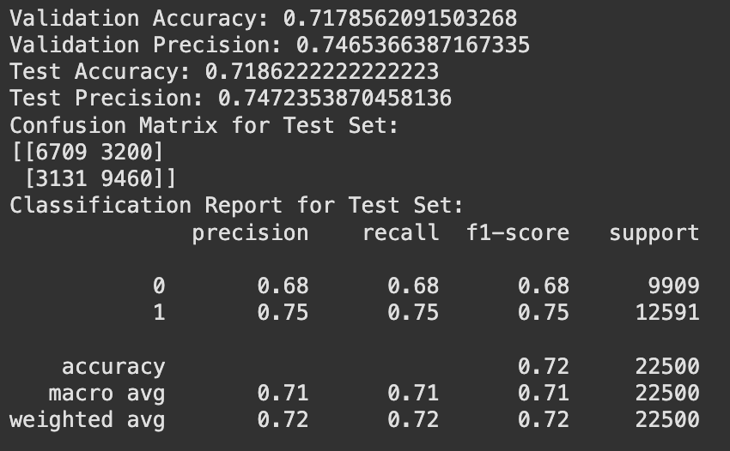
Shivam – Logistic Regression:
Results:

Slide 40
HyperParameter Tuned XGBoost Classifier
Randomized Search XGBosst Algorithm:
It is an efficient hyperparameter tuning method where a random subset of the parameter space is explored to find the best-performing combination for the model. Unlike Grid Search, which exhaustively tests all parameter combinations, Randomized Search selects a specified number of random combinations, making it faster and more practical for large parameter spaces.
Key Features:
Efficiency: Reduces computation time compared to Grid Search by sampling a subset of hyperparameters.
Flexibility: Allows specifying the number of combinations to test, providing control over the trade-off between speed and thoroughness.
Broad Exploration: Covers diverse parts of the parameter space, increasing the chances of finding good parameters.

Slide 41
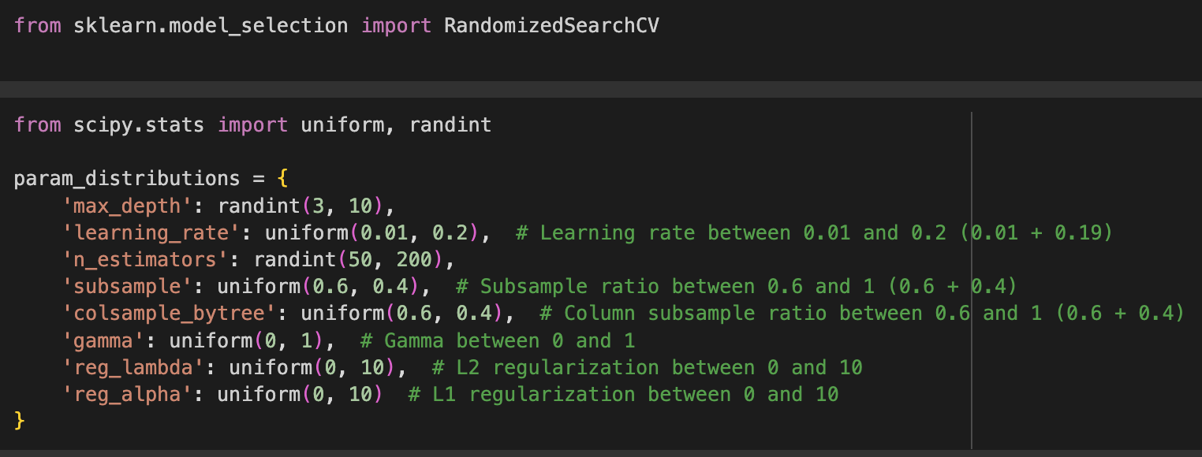
Implementing the HyperParameter Tuned XGBoost Model:

Slide 42
Results for the Randomized Search XGBoost Algorithm:
Here, we can see clearly that this tuned model performs much better than the other models and too without overfitting.

Slide 43
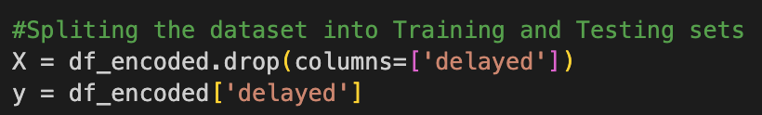
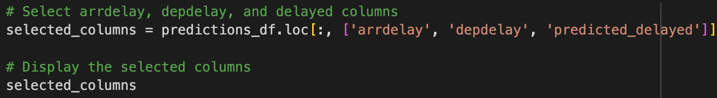
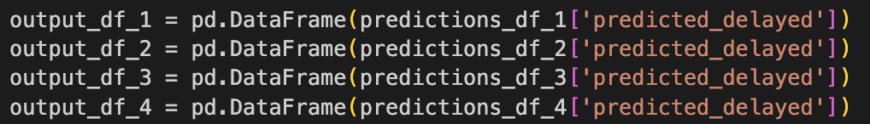
Target Dataset:

Slide 44
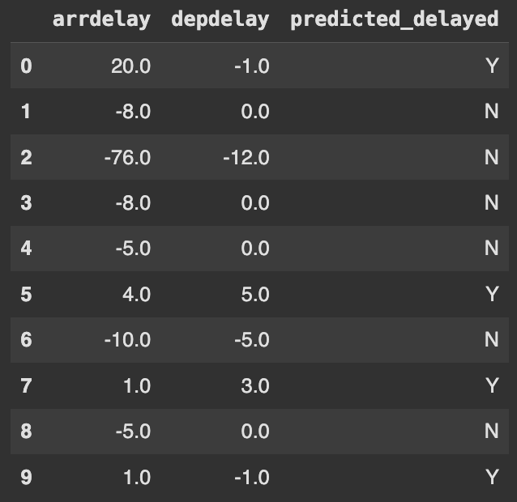
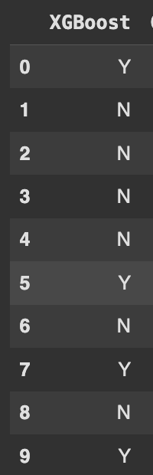
Predicted Values for Target dataset:

Slide 45


RapidMiner

Slide 46



Slide 47



Slide 48



Slide 49

Conclusion:
After the analysis we can conclude that HyperParameter Tuned Xgboost models outperform the regular XGBoost model and also don’t overfit.
After the use of RapidMiner we can say that if also performs well and gives out good results given the size of the dataset.
Overall, from all the models used by our group we had the best results by XGBoost Algorithm(Randomized search) , Hence we have used it for the group as well.

Slide 50
THANK YOU!
Group 5.
(Ali , Likhitha , Krishna , Shivam)

